Slide 1
Creativity & Innovation
BM006-3-2-CRI (VC1) 1st April 2018
INTRODUCTION & OVERVIEW

Slide 2
Lecturer information
Lecturer Name: Ms Haslina Hashim,
Email: Haslina.Hashim@staffemail.apu.edu.my
Slide <<number>> of 13

Slide 3
Pre-requisites for this course
Introduction to Management (BM 007-3-1)
Slide <<number>> of 13

Slide 4
Aims of this course
This course provides a strategy framework for managing innovations in business.
The emphasis throughout is on the development and application of models and analytical tools that clarify the interactions between competition, patterns of technological and market change, and the structure and development of internal firm capabilities.
Slide <<number>> of 13

Slide 5
Course Learning outcomes, CLOs
At the end of this course, YOU should be able to:
  Explain the importance of innovation in managing a business organisation (A3, PLO4)
  Propose models and analytical tools to support the development of the business strategy (A5, PLO10)
  Present the ideas that lead to the development of innovative business growth (A2, PLO5)
Slide <<number>> of 13

Slide 6
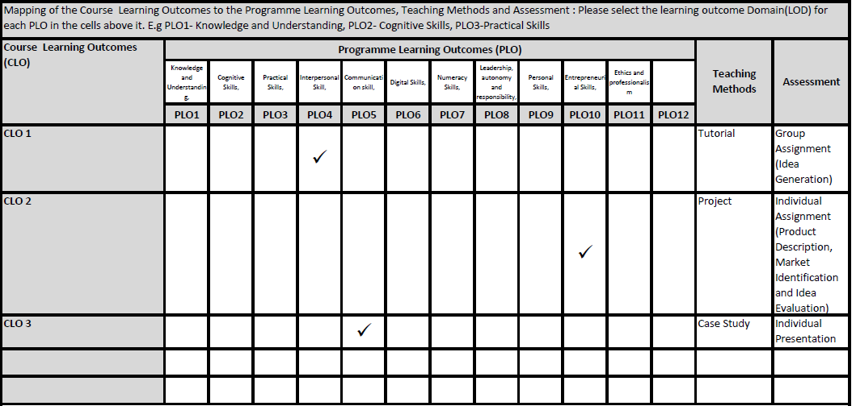
Mapping of CLOs with MOEs Domain
CLO 1: Knowledge
CLO 2: Communication Skills
CLO 3: Social skills, teamwork & responsibility
Slide <<number>> of 13

Slide 7
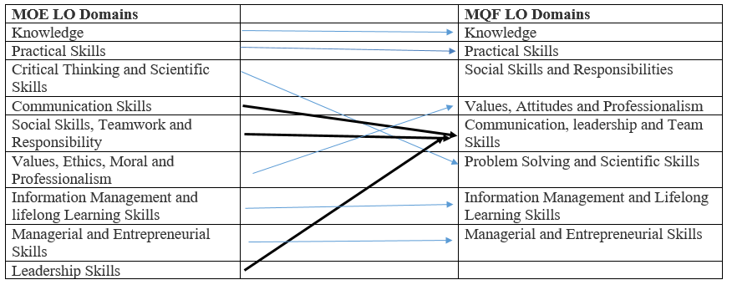
MQF and MOE Domains
Slide <<number>> of 13

Slide 8
Teaching Strategies
Lectures
Tutorials
Case Study
Slide <<number>> of 13

Slide 9
Assessment Methods
Group Assignment (Idea Generation) 30%
Individual Presentation 20%
Individual Assignment (Product Description, Market Identification and Idea Evaluation) 50%
Slide <<number>> of 13

Slide 10
ASSESSMENT METHODS AND TYPES
Poster Display – Ideation Day 20% -
Group assignment 30% -
Individual assignment 50% -
The focus theme –

Slide 11
Student Learning Time (SLT)
Course Credit Value: 3
Total Learning Hours: 120
Lecture: 18 hours
Tutorial: 28 hours
Self Learning: 27 hours
Independent Learning Time: 47 hours
Slide <<number>> of 13

Slide 12
Methods of Delivery
Hence,
We are now moving from the traditional topic based teaching to outcome-based education
Slide <<number>> of 13

Slide 13
Outcomes Based Education (OBE)
OBE is education based on producing particular educational outcomes that:
  Focus on what students can actually do after they are taught
  Expect all learners / students to successfully achieve particular (sometimes minimum) level of knowledge and abilities.
Slide <<number>> of 13

Slide 14
So…What is OBE?
It’s
NOT
What we want to teach,
It’s
What You should learn
Slide <<number>> of 13

Slide 15
Course Content Outline
Describe the concept of innovation
Explain different phases in innovation
Describe types of innovation
Explain the different theories of innovation
Explain the stages of problem solving
Discussion on Idea Generation Techniques
Discussion on Idea evaluation analysis
Discussion on intellectual property in relation to innovation
Discussion on innovation strategy
Case study on the process of innovation in industry
Slide <<number>> of 13

Slide 16
What is expected of you
What is expected of you
You should abide by all the rules & regulations of APU
  Proper attire
  No speaking in languages other than English
  Attendance is compulsory and valid medical certificates must support any absence from class.
  Three cases of lateness will be equal to one absence
  All handphones should be turned off during lectures.
Slide <<number>> of 13

Slide 17
What support is available for you
Consultation hours
Resources
  Reference material
    Essential Reading
    Smith, D. (2015) Exploring Innovation, McGraw-Hill: London. ISBN-13: 978-0077158392.
    Trott, P. (2017) Innovation Management and New Product Development, 6th Edition, Prentice Hall Financial Times: Harlow, England. ISBN-13: 978-1292133423.
    Further Reading
    Von Stam, B. (2008) Managing Innovation, Design And Creativity, 2nd Edition, John Wiley & Sons: Chichester. ISBN-13: 978-0470510667.
    Ailing, C., Liping, L., Xingsen, L., Jun, Z. and Lei, D. (2013) Study on Innovation Capability of College Students Based on Extenics and Theory of Creativity, Information Technology and Quantitative Management (ITQM2013), Procedia Computer Science Vol 17, pp1194 – 1201.
    Alice, H.Y. et al (2016) "Employee creativity and innovation in organisations", International Journal of Contemporary Hospitality Management, Vol. 28 Iss 5 pp. 862 – 885.
Slide <<number>> of 13

Slide 18
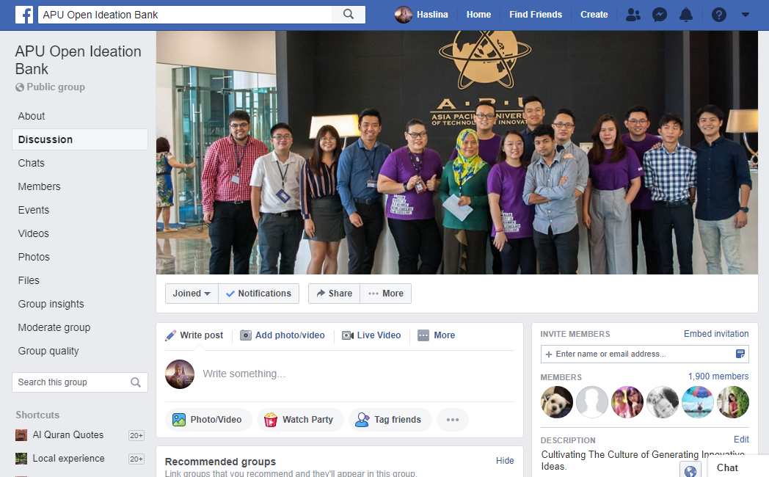
Facebook group

Slide 19
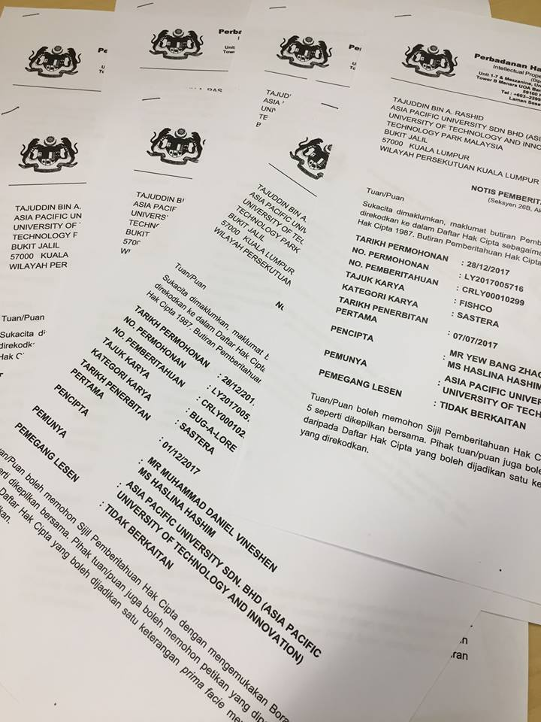


Slide 20


Slide 21

APU Ideation Lab Facebook Group
http://bit.do/APU-Ideation-Lab

Slide 22
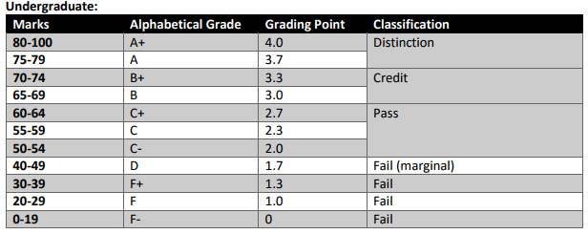
Achievement requirements
Slide <<number>> of 13

Slide 23
Question and answer session
Q & A
Slide <<number>> of 13

Slide 24
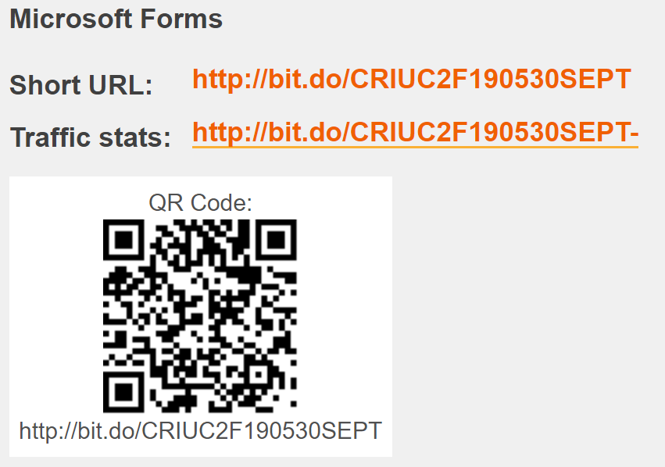
Attendance

Slide 25
What we will cover next
Describe the concept of innovation
Explain different phases in innovation
Slide <<number>> of 13

Slide 26
Tutorial group discussion
By 2050 we will need to reconcile the growing food demands of an ever-increasing global population with an expanding global middle class and rapidly shifting, more intense weather changes. In this volatile environment, a future that includes a resilient food system needs four building blocks:
1. Efficient agricultural production that takes advantage of innovative technologies and practices
2. Tailored trade and investment approaches
3. Well-functioning domestic markets
4. Strategic reserves of food and water
Get more recommendations on creating a well-fed planet into the future in "From liability to opportunity: How to build food security and nourish growth":
Source: http://www.mckinsey.com/insights/Food_Agriculture/From_liability_to_opportunity_How_to_build_food_security_and_nourish_growth

Slide 27
Agriculture technology and innovation
Evaluate each of the innovative project from this website.
https://www.forbes.com/sites/maggiemcgrath/2017/06/28/the-25-most-innovative-ag-tech-startups/#282450e64883

Slide 28
